Slide 1
Introduction to Machine Learning
© Templateswise.com
Music Mood Classification
Naveen Kumar Mishra

Slide 2
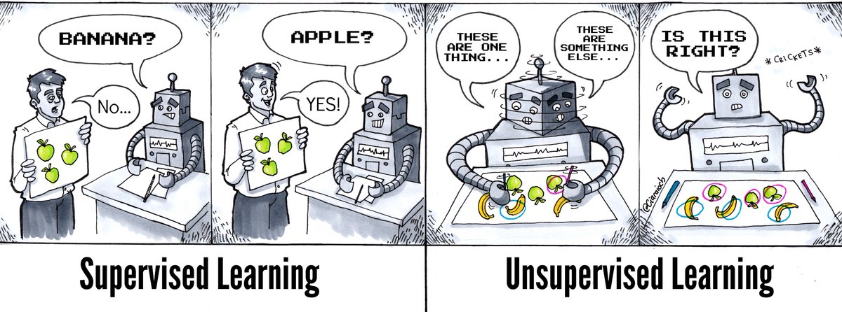
INTRODUCTION to PROJECT

Slide 3
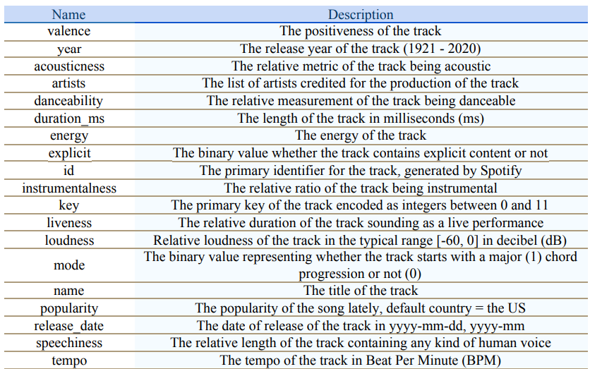
Dataset Information
Dataset with 170,654 rows and 19 columns without a target feature
Songs from 1921 to 2020

Slide 4
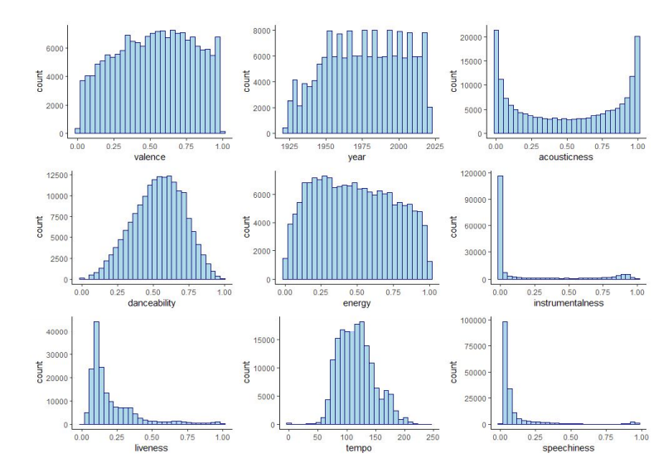
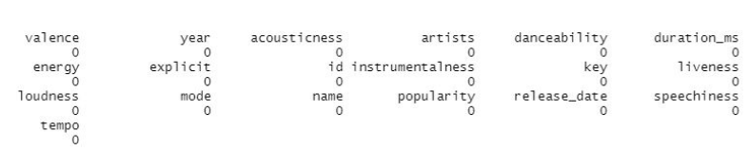
Data Visualization
Values are normalized between 0 and 1.
No missing values in the columns and no duplicates.

Slide 5
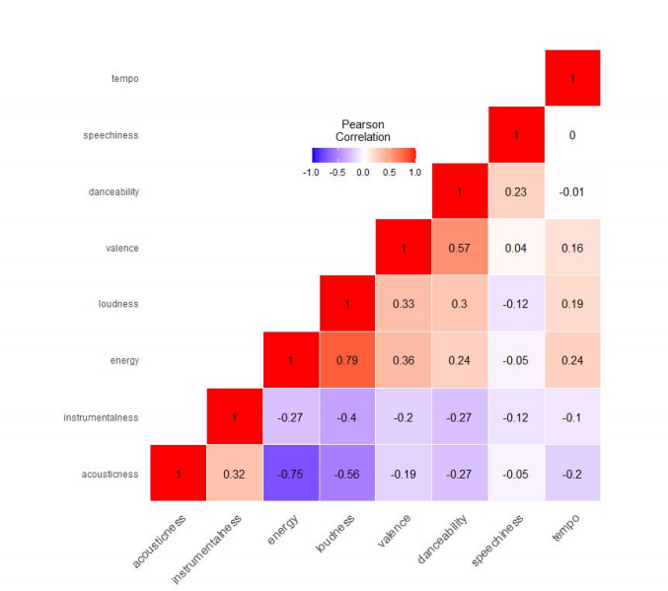
CONT’D
Red represents high correlation, blue represent low correlation.
High correlation between energy and loudness.
Pearson correlation is used.

Slide 6
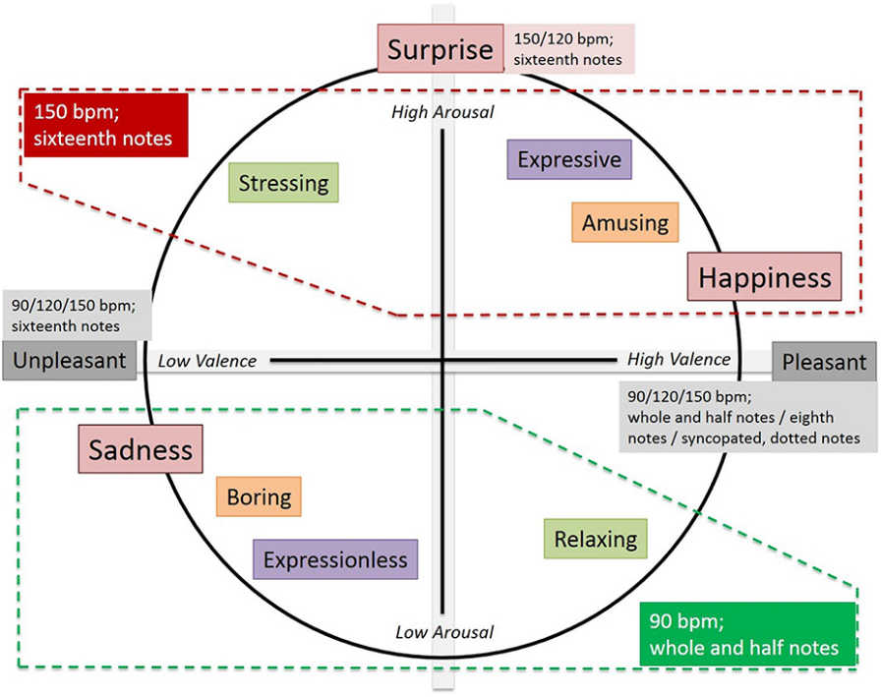
CLUSTERING DATA

Slide 7
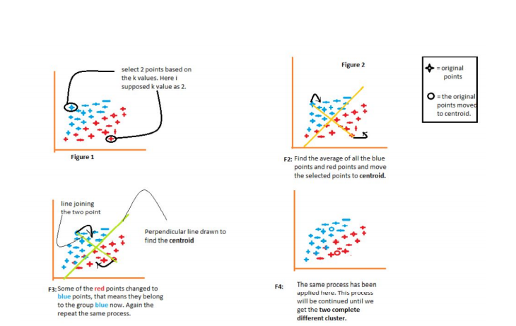
k-means Clustering Algorithm
1- Select the k values.
2- Initialize the centroids.
3- Select the group and find the average.

Slide 8
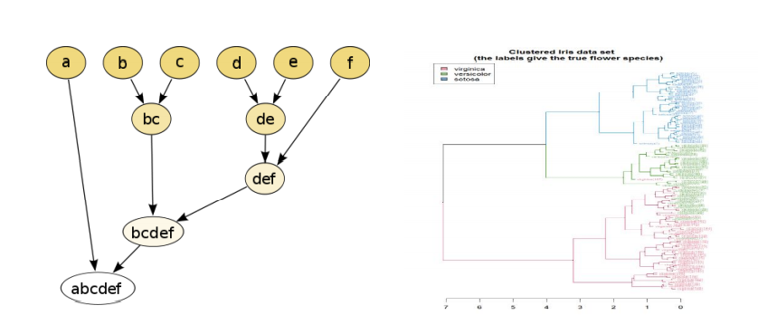
Hierarchical Clustering Algorithm
- Agglomerative: This is a "bottom-up" approach: each observation begins in its cluster, and as one moves up the hierarchy, pairs of clusters are combined.
- Divisive: This is a "top-down" approach: all observations begin in one cluster, and as one moves down the hierarchy, splits are carried out recursively.

Slide 9
Silhouette Score
Silhouette Coefficient or Score is a metric used to calculate the goodness of a clustering technique. Its value ranges from -1 to 1.
● 1 means that clusters are well apart from each other and distinguished.
● 0 Means that clusters are indifferent or the distance between the clusters is not significant
● -1 Means that clusters are assigned to the wrong clusters.
Silhouette Score = (b-a)/max(a,b)
● a= average intra-cluster distance i.e the average distance between each point within a cluster.
● b= average inter-cluster distance i.e the average distance between all clusters.

Slide 10
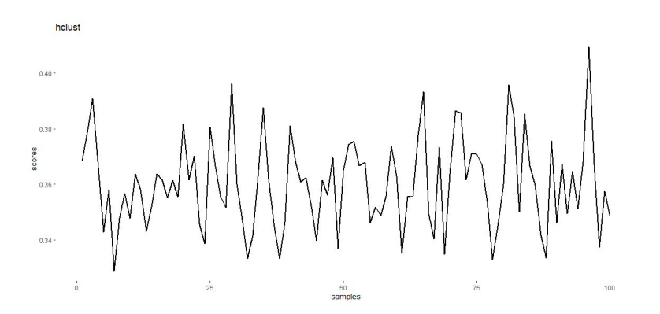
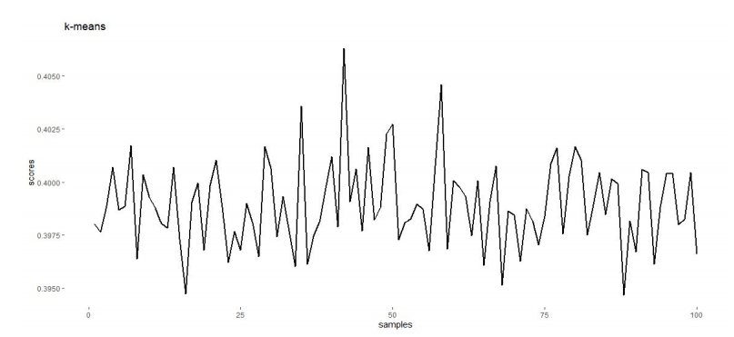
Comparison of Algorithms
The highest silhouette score for hclust is the 96th sample with 0.409287.
The highest silhouette score for k-means is the 42nd sample with 0.4062914.

Slide 11
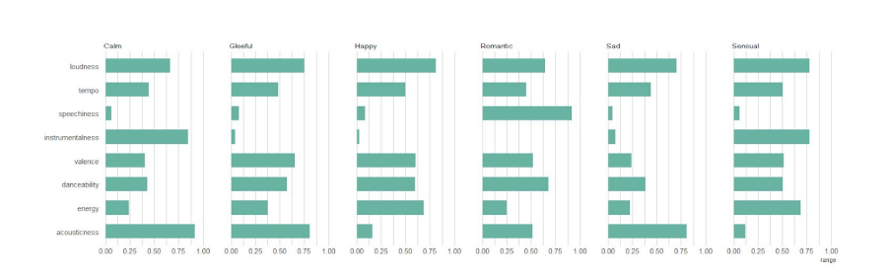
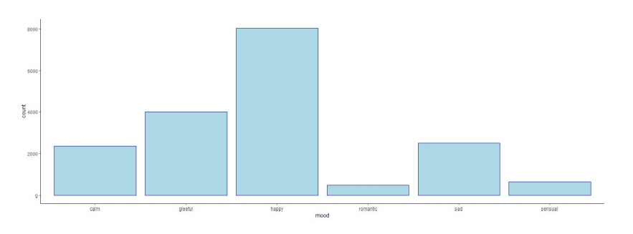
Mood Creation
Key features are valence, energy and acousticness.
8027 happy songs
3989 gleeful songs
2495 sad songs
2362 calm songs
484 romantic songs
643 sensual songs

Slide 12
CLASSIFICATION MODELS

Slide 13
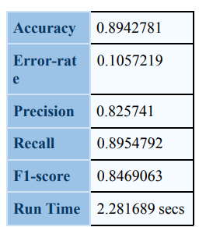
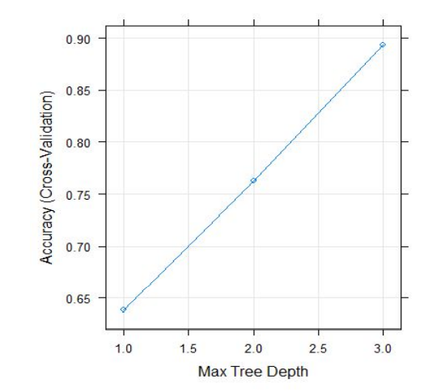
Decision Tree Model
In the study, the "rpart2" method of train function was used while creating the decision tree model.
There is "max tree depth" as a parameter in this method. Selects the deepest tree with the best accuracy for the dataset used by tuning through the max tree depth parameter in the modeling train function.
MaxDepth = 3 with the accuracy of 0.89.

Slide 14
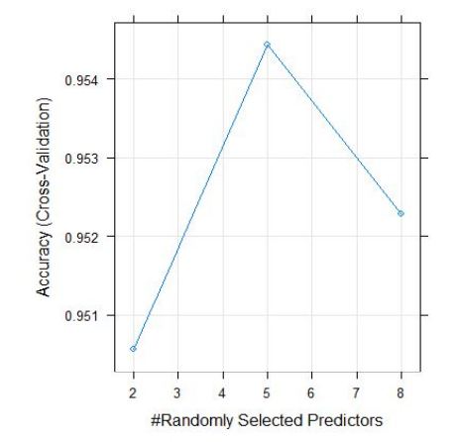
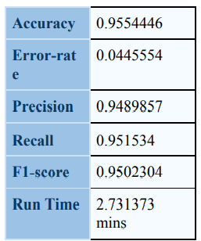
Random Forest Model
Random Forest modeling in the study, the "rf" method within the train function was used.
This method includes the "number of randomly selected predictors (mtyr)" as parameters.
The accuracy rate obtained with this parameter is 0.9554446.

Slide 15
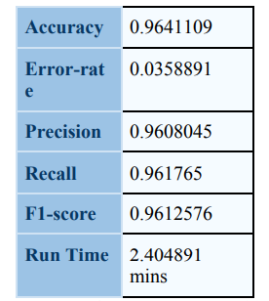
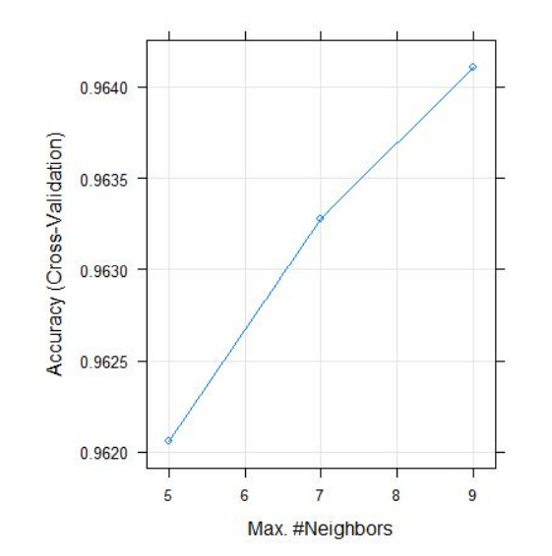
K-Nearest Neighbors Model
In K-Nearest Neighbors modeling, the "kknn" method was used in the train function. The use case of "k value", "distance value" and "kernel" to be used in this method is used as parameters.
k max = 9, distance = 2, and kernel = optimal. With these values, the accuracy rate is 0.964110.

Slide 16
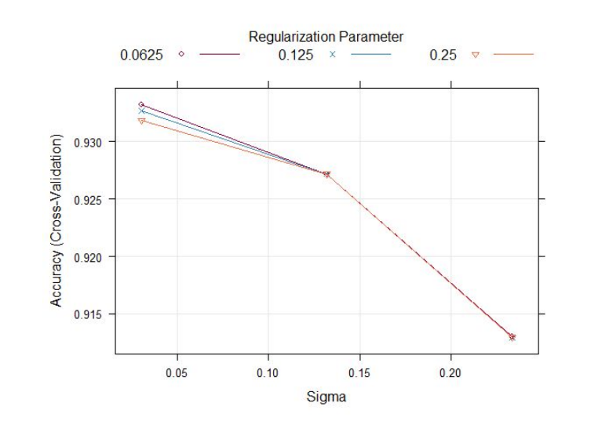
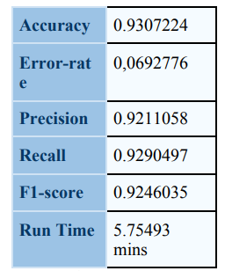
Support Vector Machine Model
In the Support Vector Machine modeling, "lssvmRadial" is used as a method in the train function. This method includes "sigma" and "tau" values as parameters.
The highest accuracy is 0.9307224. For this reason, the value of sigma 0.03059712 tau 0.0625 was chosen.

Slide 17
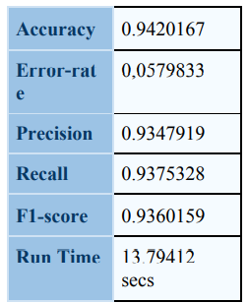
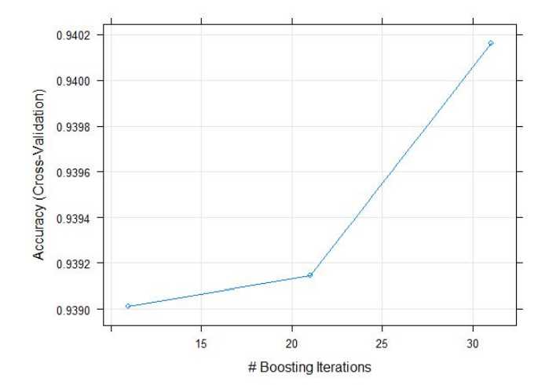
Logistic Regression Model
"LogitBoost" was used as a method in Logistic Regression modeling. This method contains the parameter "number of boosting iterations (nIter)".
For nlter 11, accuracy is 0.9394192 for nlter 21, accuracy is 0.9420167 for nlter 31, is 0.9401334.

Slide 18
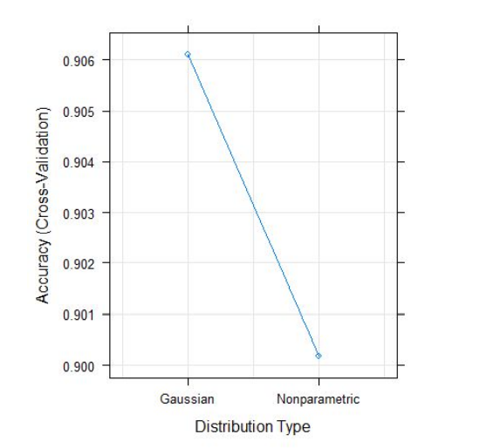
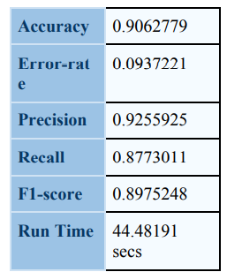
Naive Bayes Model
The "nb" method was used in Naive Bayes modeling. In this method, there are "Laplace correction", "distribution type", "bandwidth adjustment" values as parameters.
The last values used for the model were fL= 0, usekernel = False and adjust = 1.
When kernel = false, the accuracy rate is 0.9062779.

Slide 19
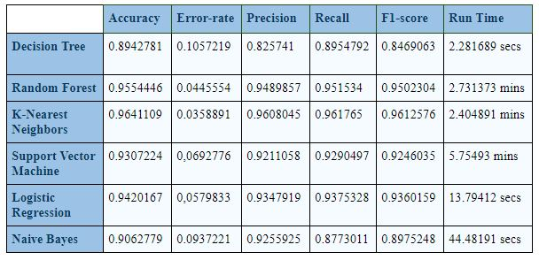
CONCLUSION
Evaluation metrics are available for all models above. The model with the highest accuracy, precision, recall, and F1-score for the dataset is K-Nearest Neighbors. The fastest model in terms of runtime is the Decision Tree, but it has the lowest accuracy. Additionally, the slowest model is the Support Vector Machine.
Based on the table results, the Decision Tree model can be selected for its average accuracy rate, while the K-Nearest Neighbors model can be chosen for its average runtime when considering all other metrics.

Slide 20
THANKS FOR LISTENING!
ANY QUESTIONS?

